Slide 1

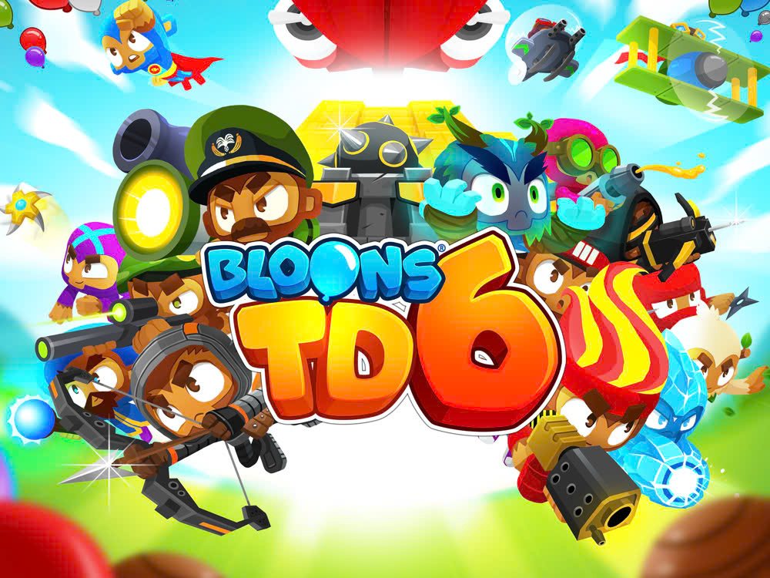
Object-oriented Programming
Bloons Tower Defense
Join us as we delve into the world of Balloon Tower Defense, a captivating new game that combines strategic tower defense with an enchanting balloon-themed world.
INSTRUCTOR:
Assoc. Prof. Tran Thanh Tung and Nguyen Trung Nghia
Notes:
1

Slide 2
Object-oriented Programming
Member
Nguyen Minh Khoi - ITCSIU22210
Vuong Quan Sieu - ITCSIU22270
Truong Huy Hoang - ITCSIU22228
Huynh Trinh Phuc Thinh - ITCSIU22230

Slide 3
Object-oriented Programming
Table of Content
Chap 1: Introduction
Chap 2: System Design
Chap 3: Design and Implementation
Chap 4: Final game product
Chap 5: Experience

Slide 4
Object-oriented Programming
INTRODUCTION
1.1 Introduction to the Game
Bloons Tower Defense (BTD), a popular tower defense game, has been a subject of interest for its simple yet captivating gameplay and endless creativity.
Originally released in 2007, BTD features monkeys defending against balloons, offering a unique blend of strategy and entertainment.
This project aims to recreate BTD's engaging gameplay, improve essential skills like programming, UI/UX design, and strategic thinking.
Notes:
2

Slide 5
Object-oriented Programming
INTRODUCTION
1.2 About the Project
The "Bloons Tower Defense" project is a strategy-based game in Java where players strategically place towers to defend against enemy waves.
The aim is to create an interactive, functional tower defense game, inspired by the original Bloons Tower Defense, with creative elements to enhance the player experience by balancing tower placement and upgrade choices.

Slide 6
Object-oriented Programming
INTRODUCTION
1.3 Our Bloons Tower Defense
Building upon the original Bloons Tower Defense, we aim to:
Retain familiar elements such as the monkey characters, balloons, and tower defense gameplay.
Introduce new features, including:
Unique weapons and skills for each monkey.
Special balloons with their own challenges.
New sounds and effects to make the game more engaging and refreshing.

Slide 7
2. SYSTEM DESIGN

Slide 8
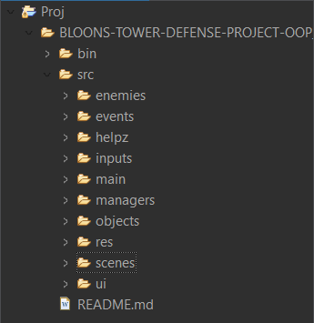
PACKAGE STRUCTURE
9 PACKAGES
37 CLASSES

Slide 9
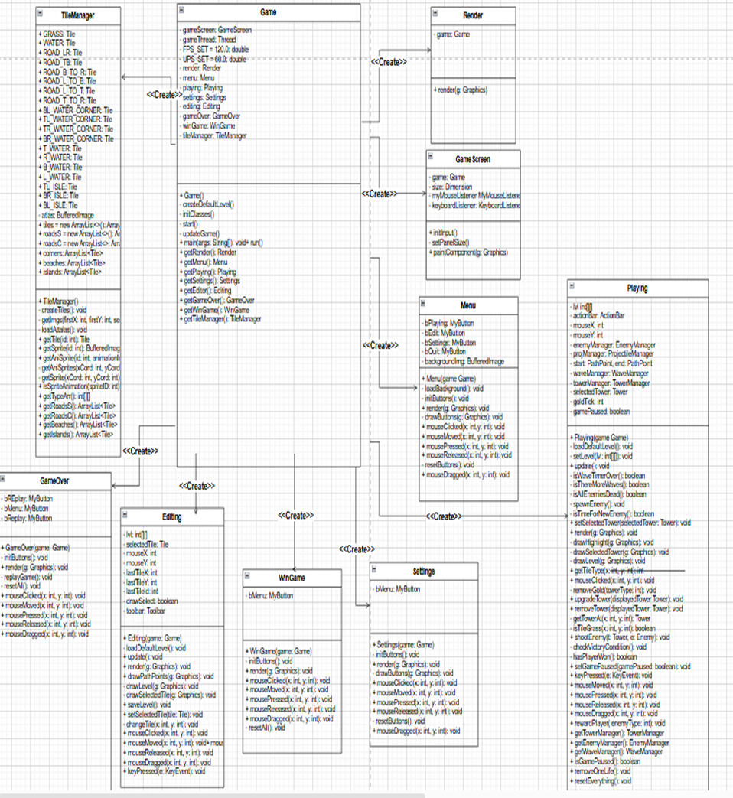

Slide 10
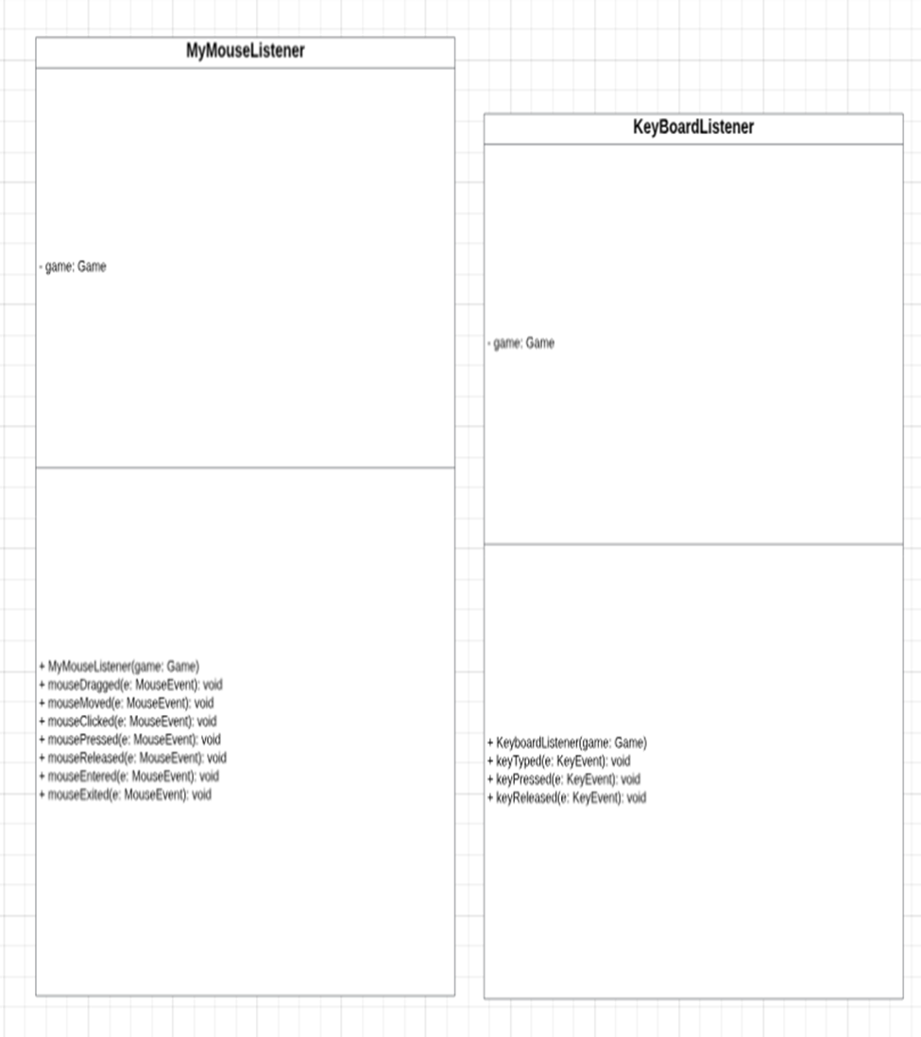

Slide 11
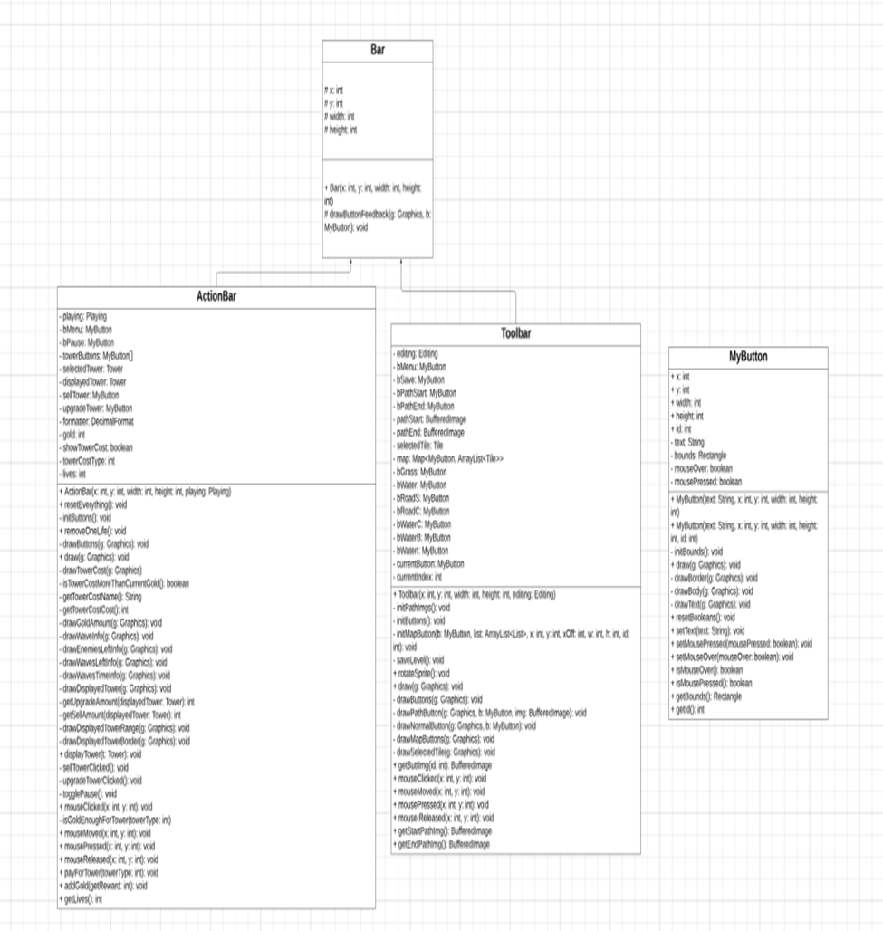

Slide 12
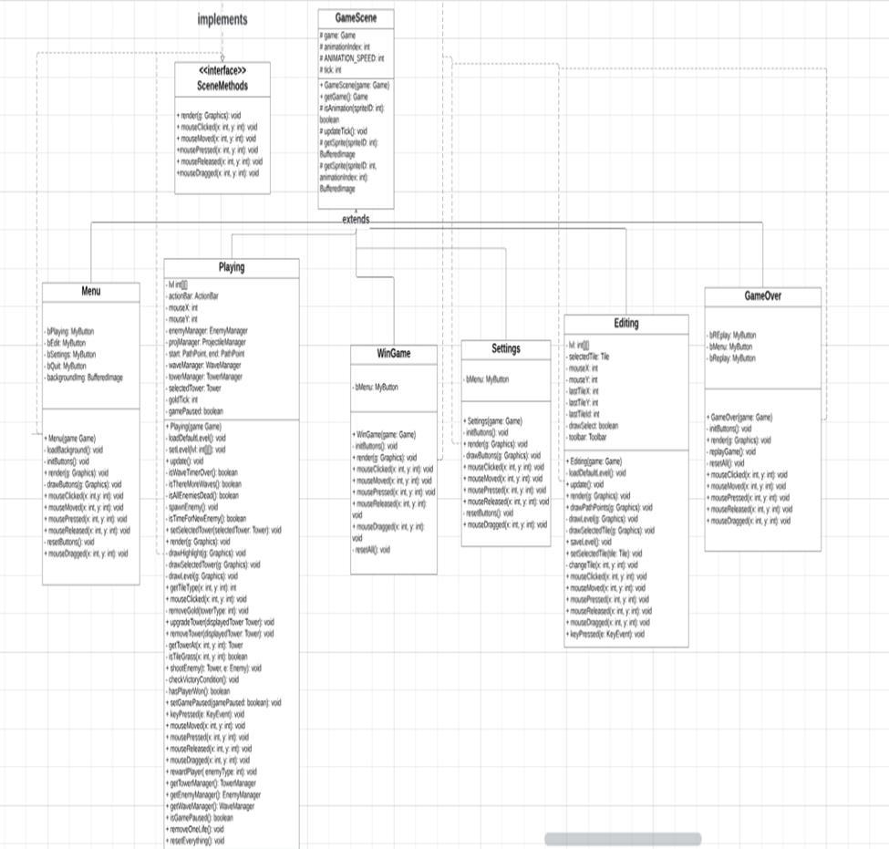

Slide 13
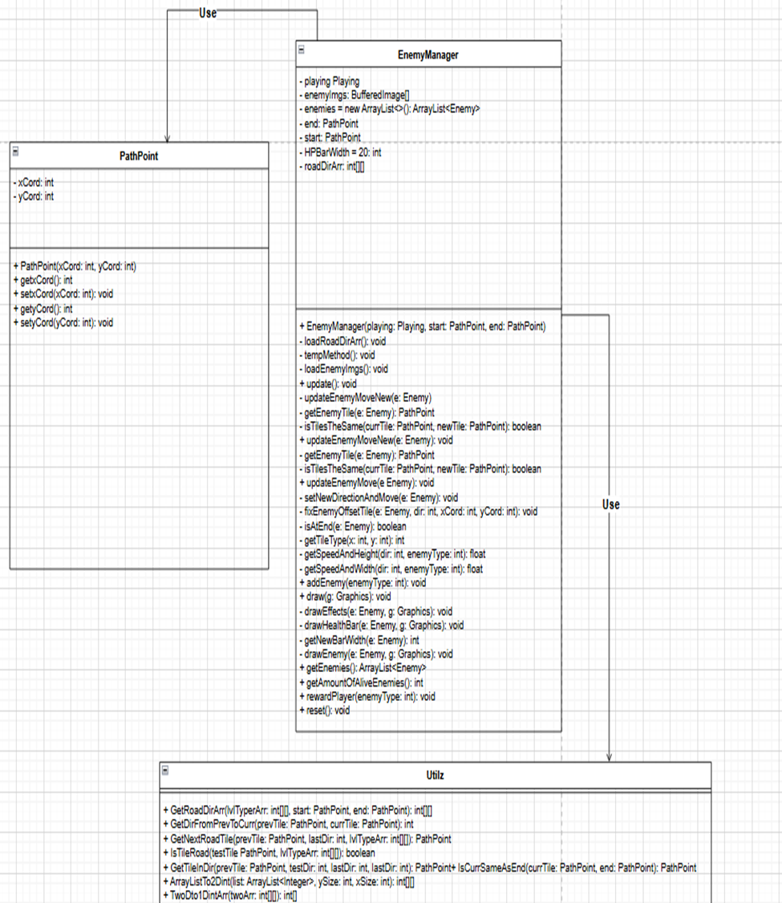

Slide 14
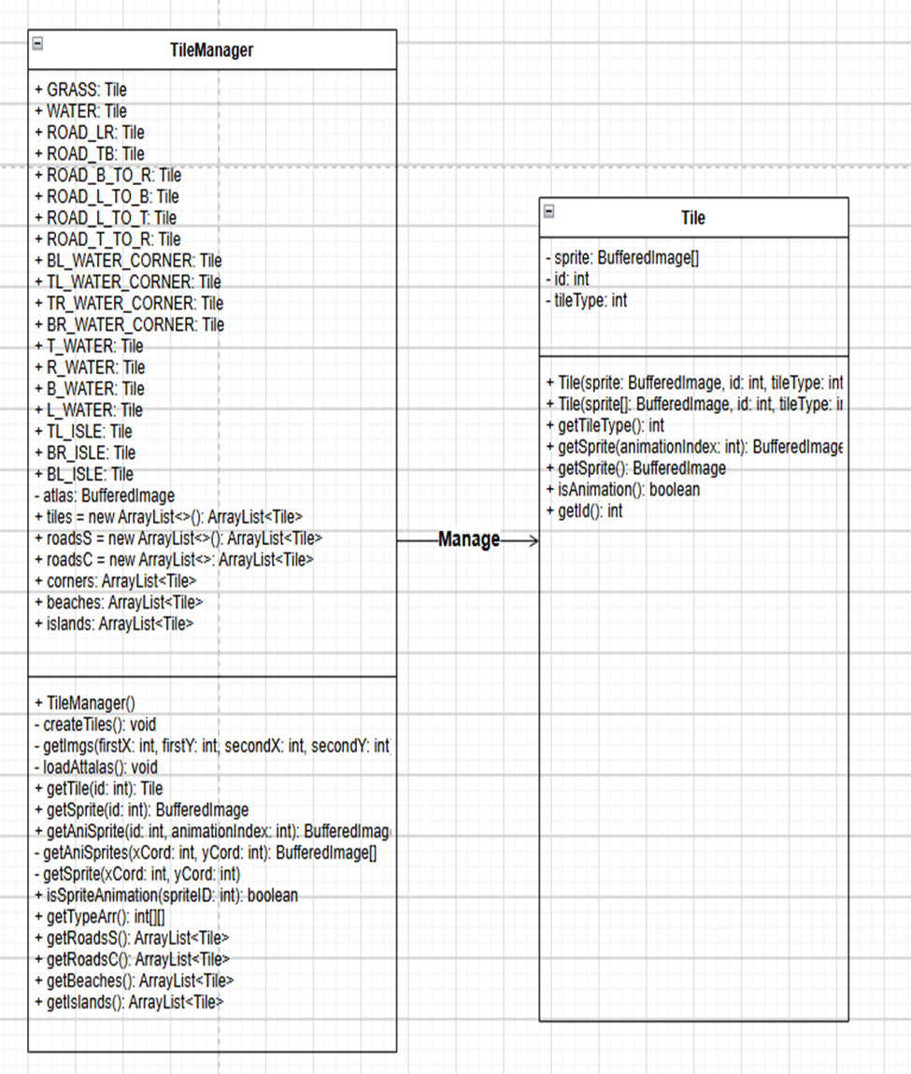

Slide 15
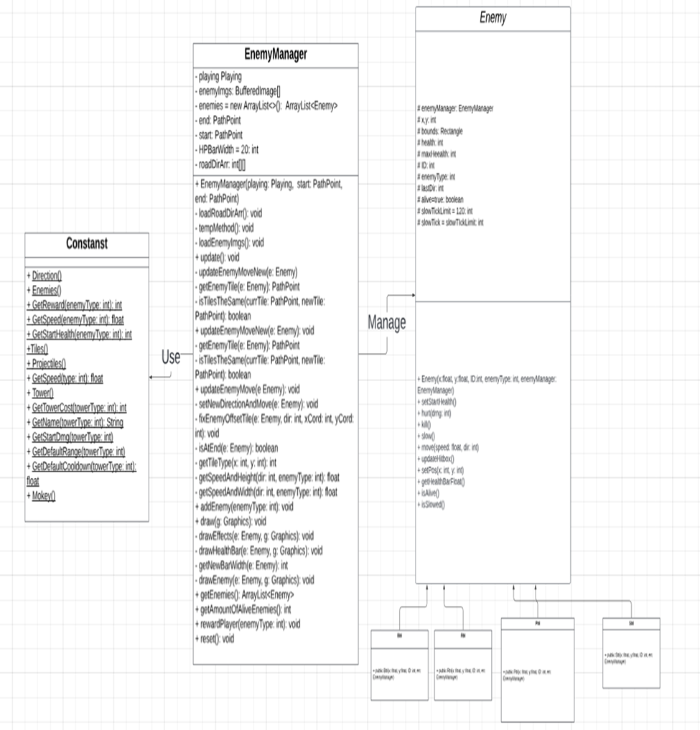

Slide 16
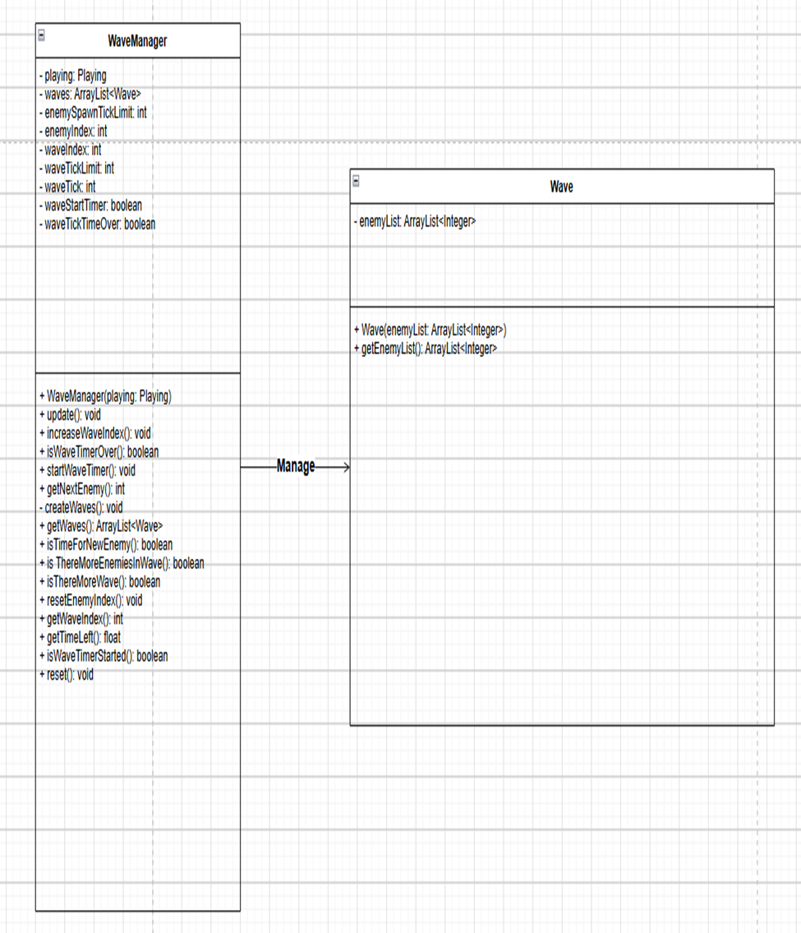

Slide 17
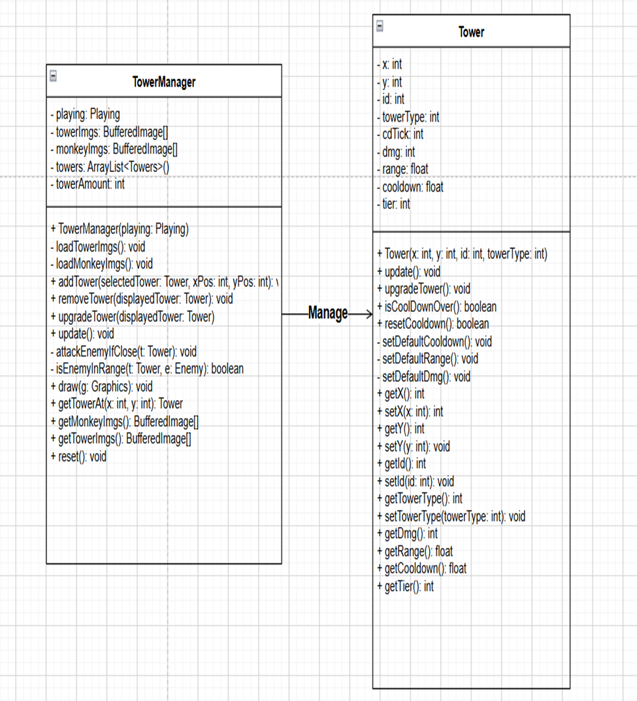

Slide 18
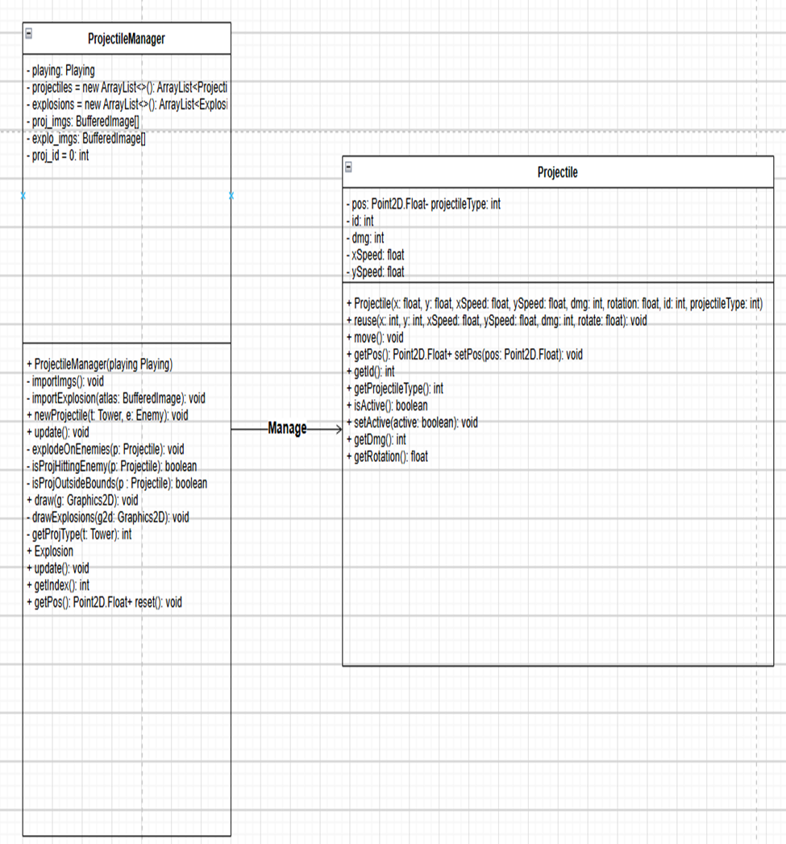

Slide 19
3. Implementation code

Slide 20
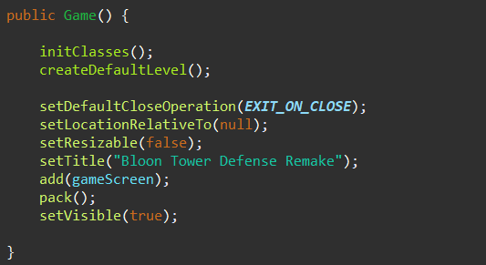
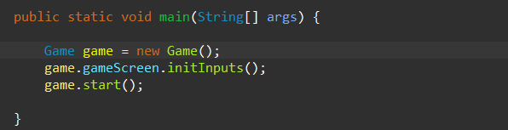
3.1 Game Initialization
Notes:
3

Slide 21
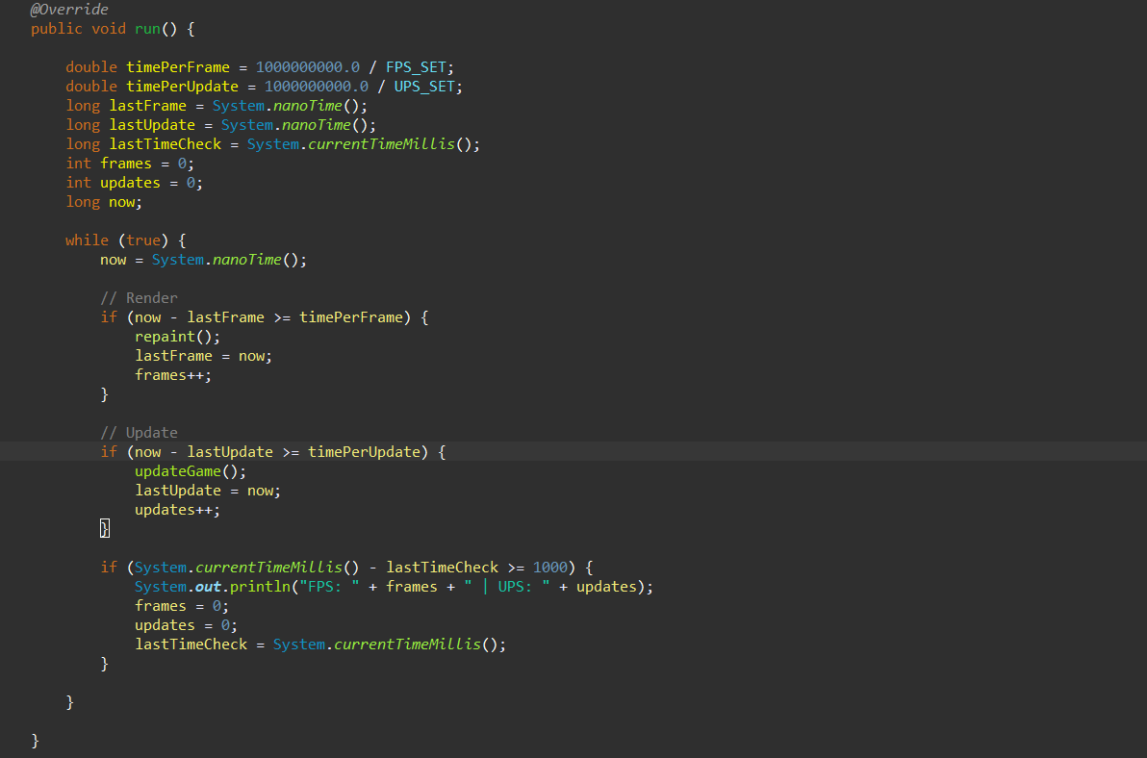
3.2 Game Loop
Notes:
3

Slide 22
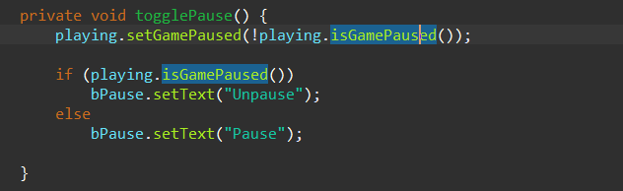
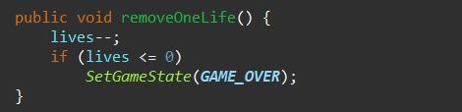
3.3 Game State Management
Notes:
3

Slide 23
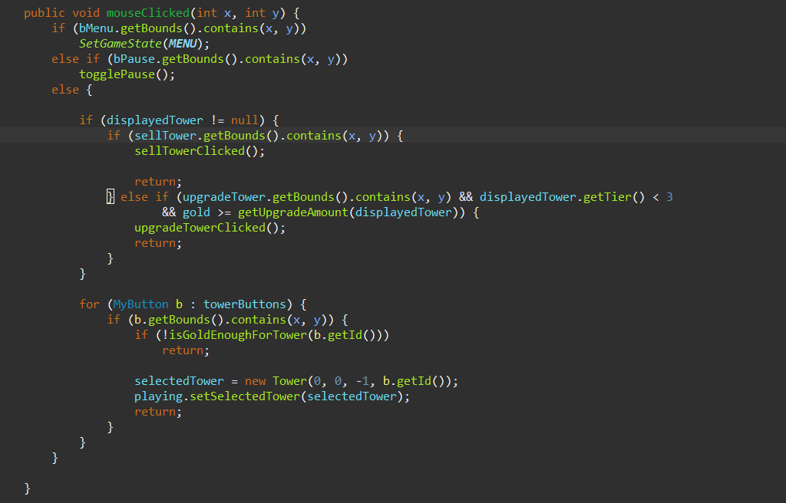
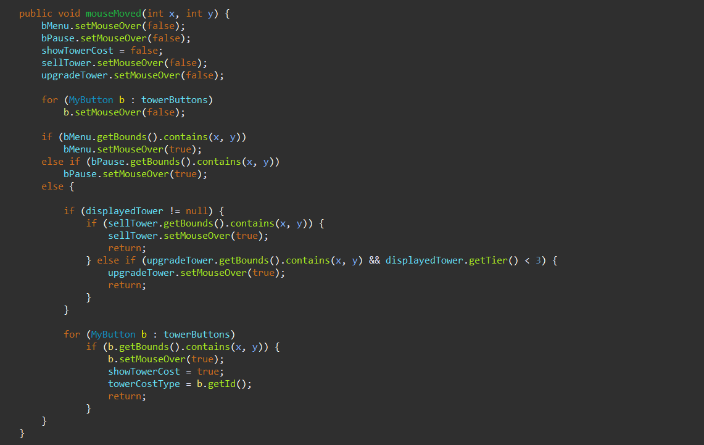
3.4 Tower Control
Notes:
3

Slide 24
3.4 Tower Control
Notes:
3

Slide 25
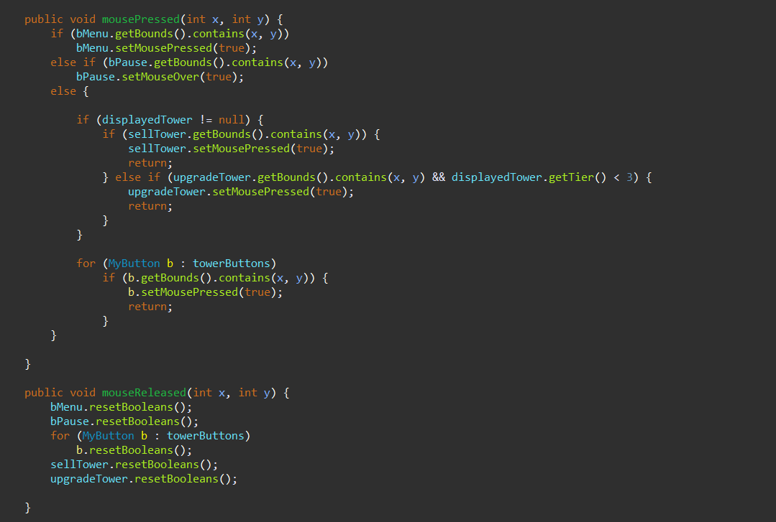
3.4 Tower Control
Notes:
3

Slide 26
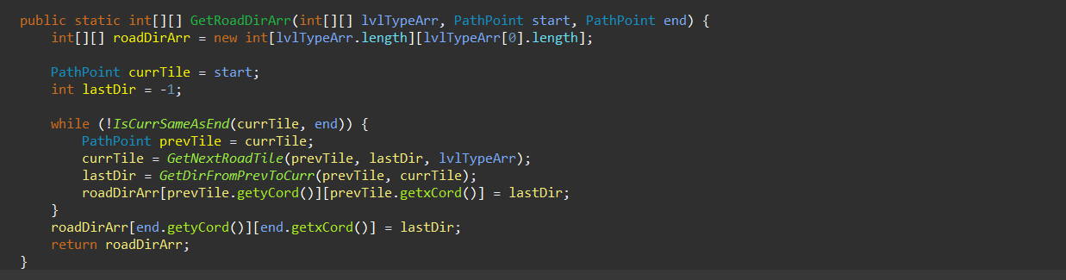
3.5 Special features
3.5.1 Pathfinding
Notes:
3

Slide 27
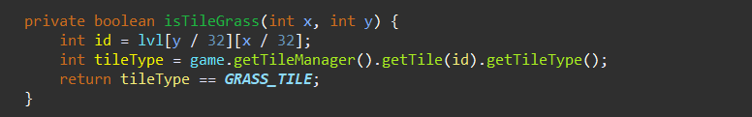
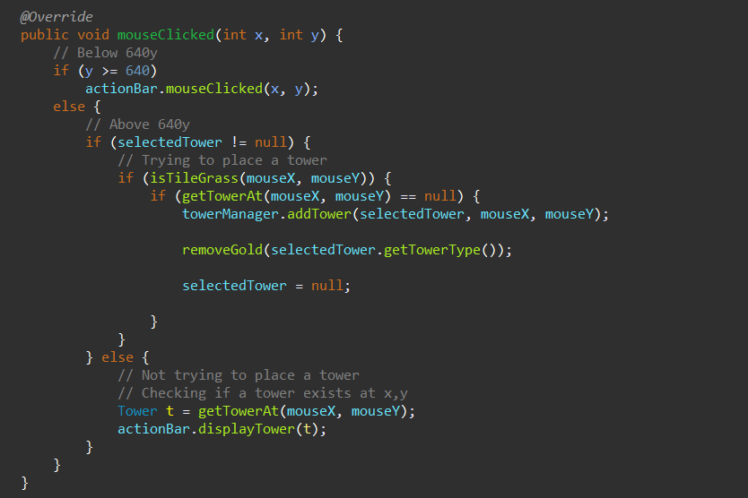
3.5 Special features
3.5.2 Tower placement
Notes:
3

Slide 28
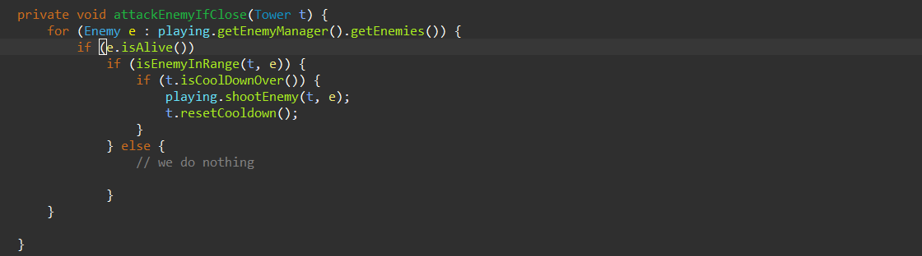
3.5 Special features
3.5.3 Tower Attack Mechanics
Notes:
3

Slide 29
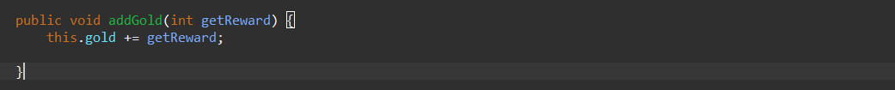

3.5 Special features
3.5.4 Rewards
Active gold reward:
Passive gold reward:
Notes:
3

Slide 30
4. Final Game Product

Slide 31




List of ballons:
Red Balloon:
The red balloon has 10 HP, the lowest speed, and rewards the player with 3 gold when destroyed.
Blue balloon:
The blue balloon has 20 HP, moves faster than the red balloon, and rewards the player with 5 gold when destroyed.
Purple balloon:
The purple balloon has 30 HP, moves faster than purple balloon, and rewards the player with 8 gold when destroyed.
Special balloon::
The special balloon has 40 HP, the fastest speed, and rewards the player with 10 gold when destroyed.
Notes:
6

Slide 32




List of towers:
Dart Monkey
Ninja monkey
Super Monkey
Notes:
4

Slide 33
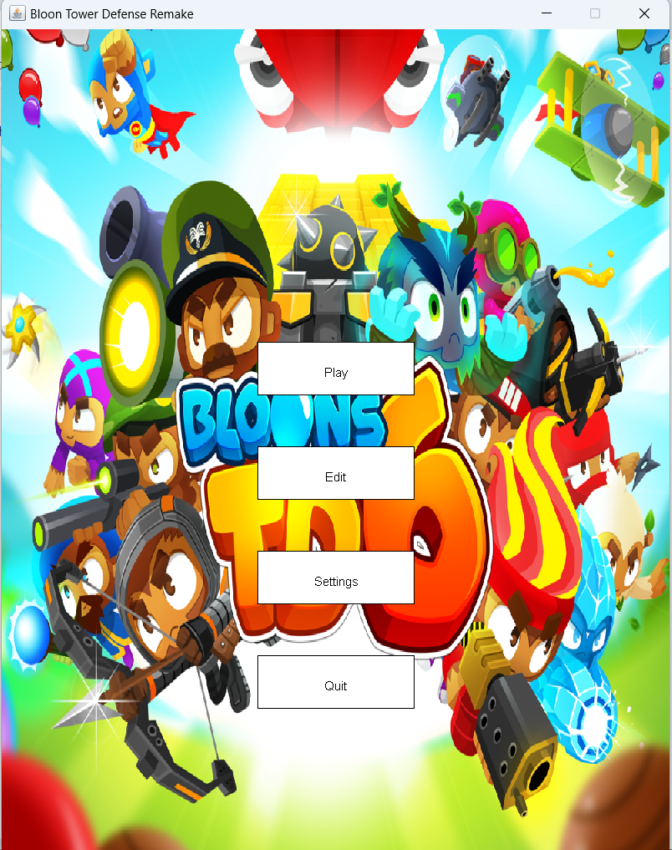
Main Menu:
Notes:
5

Slide 34
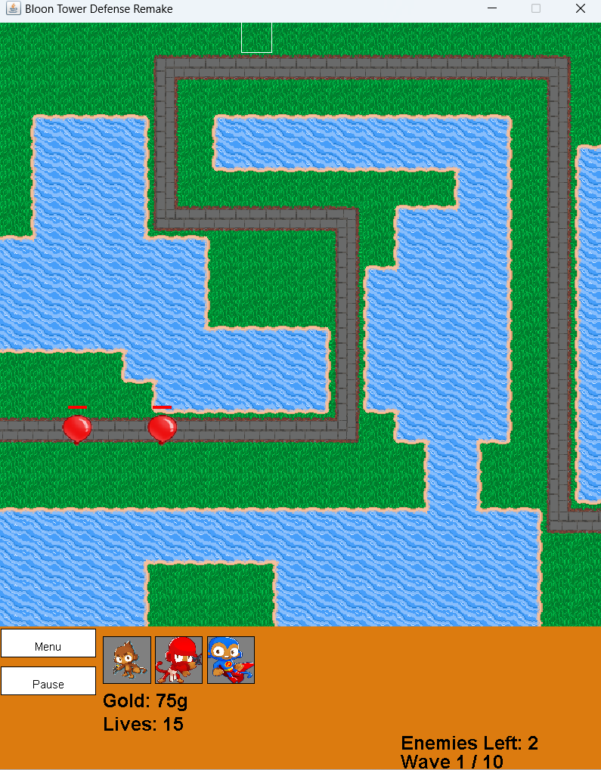
In-Game Screen:
Notes:
5

Slide 35
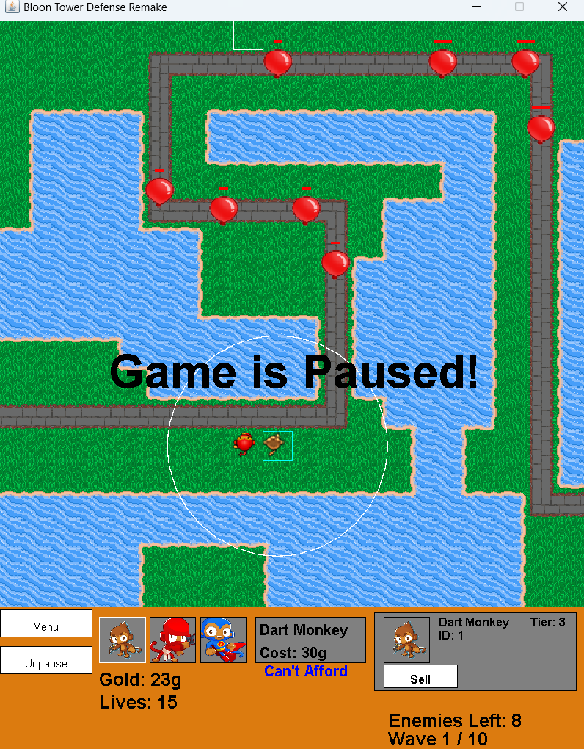
In-Game Screen:
Notes:
5

Slide 36
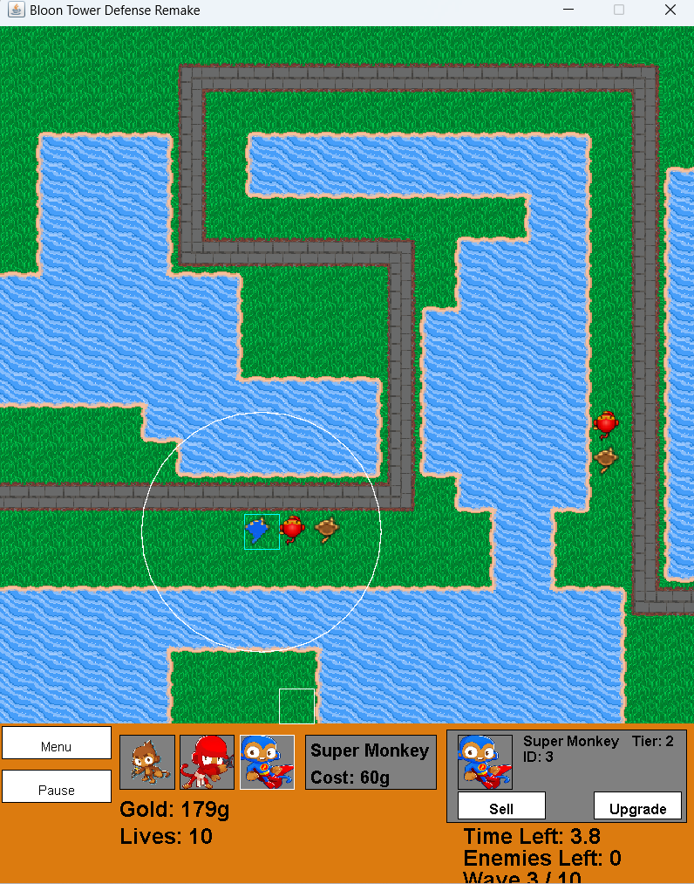
In-Game Screen:
Notes:
5

Slide 37
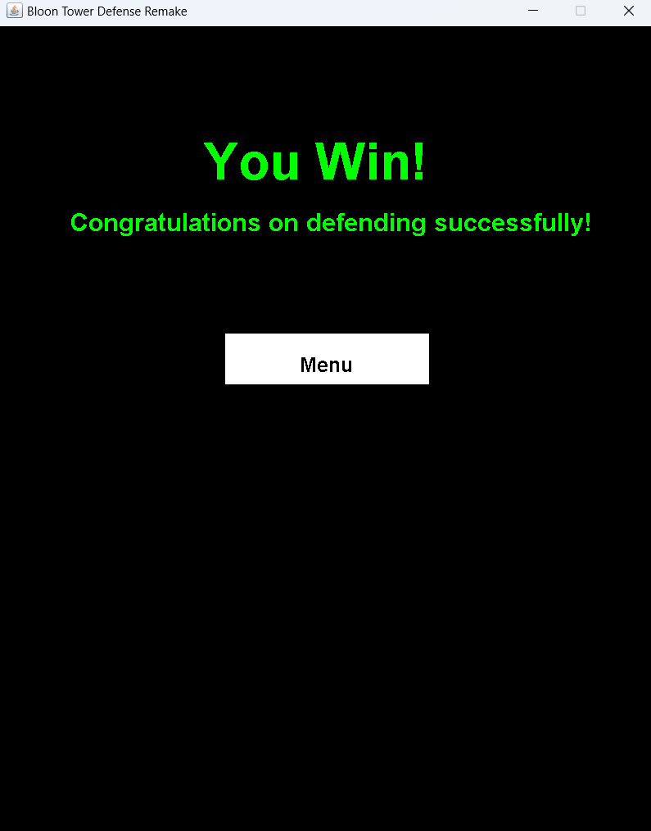
Win Game Screen:
Notes:
5

Slide 38
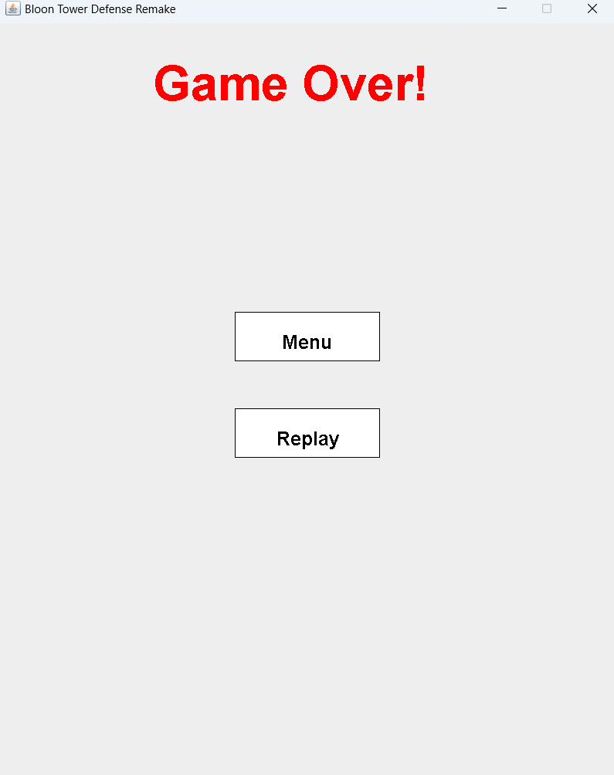
Game Over Screen:
Notes:
5

Slide 39


5. Experience
1
2
Experiment Overview
Current Features
A project to learn OOP course through game development.
Focused on designing levels, mechanics, and programming towers to enemies.
Balancing difficulty while maintaining engagement.
Monkey upgrades, victory and defeat screens.
Debugging and optimization for smooth gameplay.
3
Future Plans
Add background music, sound effects, new levels, and interactive features.
Aim to enhance player engagement and improve skills in game development.
Notes:
10

Slide 40
Thank you for listening. Any questions?
Notes:
7

